Slide 1
Intel Products Sentiment
Analysis from Online Reviews
Intel Unnati Industrial Training Program 2024
Author: Moses Makuei
Affiliation: FEAT – DMIHER

Slide 2
Outline
Project Overview
Problem statement
Technical Flow
Technologies Used
Products under scope
Conclusion
2

Slide 3
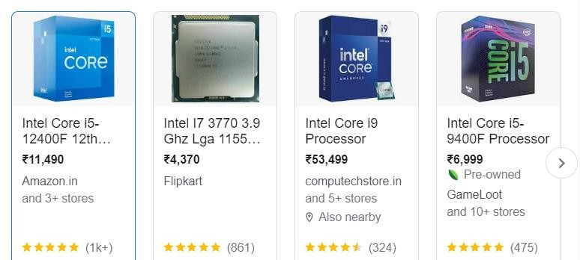
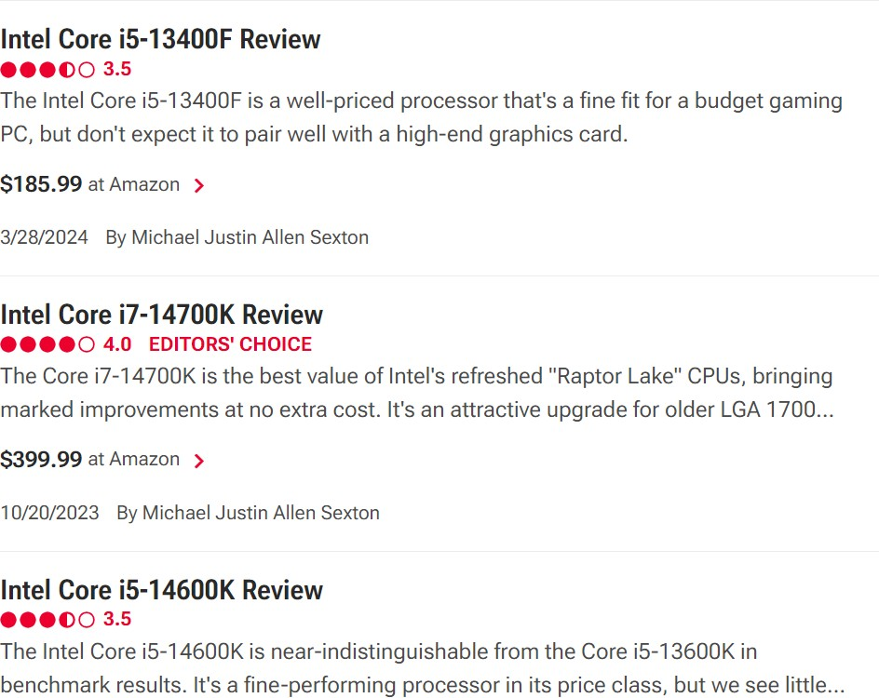
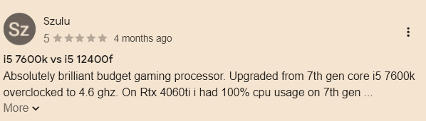
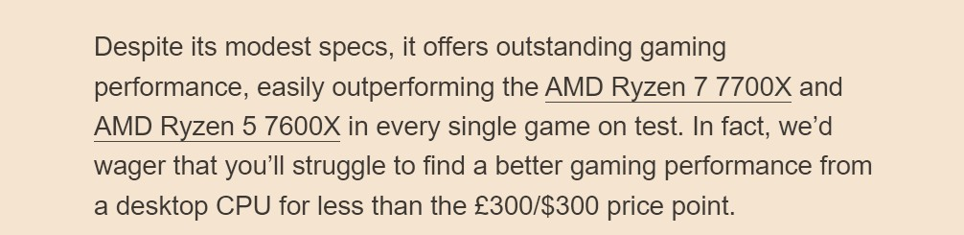
Project Overview
Intel Products are reviewed by end users and tech reviewers on various platforms.
Category A : End Users/Buyers Reviews
Amazon, Flipkart or any ecommerce platform
Category B : Technical Reviews by Experts
https://www.pcmag.com/categories/processors/brands/intel https://www.anandtech.com/show/18740/the-intel-core-i3-13100f-review-
finding-value-in-intels-cheapest-chip
https://www.trustedreviews.com/best/best-intel-processor-3517396
3

Slide 4
Problems Statement
Perform the Sentiment Analysis based on online reviews
Neutral / Users Tech Experts future expectation
Positive Sentiments
Negative Sentiments
Scope : Intel Core Processors (Mobile/Desktop)
Out of Scope : GPU, Server, Wireless, FPGA, Ethernet Products
4

Slide 5

Technical Flow
Downloaded Amazon “Electronics” reviews from here and scrapped out intel reviews
https://amazon-reviews-2023.github.io/ _
Arrange data in readable/structured format
Perform segmentation analysis based on processor type etc
Attempt various exploratory data analysis
Performed NLP techniques and vectorizations, dimensionality reduction & data imbalance handling etc.
Attempt various ML classification Models and evaluate best model based on performance metrics
Extract Feature which defines sentiment class or cluster
Clean data using the various natural language processing techniques like stop words removal, punctuation, special characters

Slide 6
Technologies Used
Supervised
Support Vector Classifier
Random Forest
XGBoost
Decision Tress
Embeddings/Lib/Approach
VADER
RoBERTa
Data Balancing Techniques
Synthetic Data Generation (SMOTE)
Undersampling

Slide 7

Products under scope
Intel® Core desktop processors (14th gen) 13th Gen Intel® Core desktop processors
13th Gen Intel® Core 12th Gen Intel® Core 12th Gen Intel® Core
mobile processors desktop processors mobile processors
Core i3, i5, i7 and i9

Slide 8
Conclusion
The project was successfully completed. The dataset for this project was collected from amazon reviews using web scrapping techniques and more downloaded from hugging face dataset https://amazon-reviews-2023.github.io/ and cleaned.
A classification sentiment analysis model was developed using various machine learning and NLP techniques providing different accuracies under different evaluation performance metrics.

